Slide 1


Copyright and Piracy
ICT and the Law

Slide 2
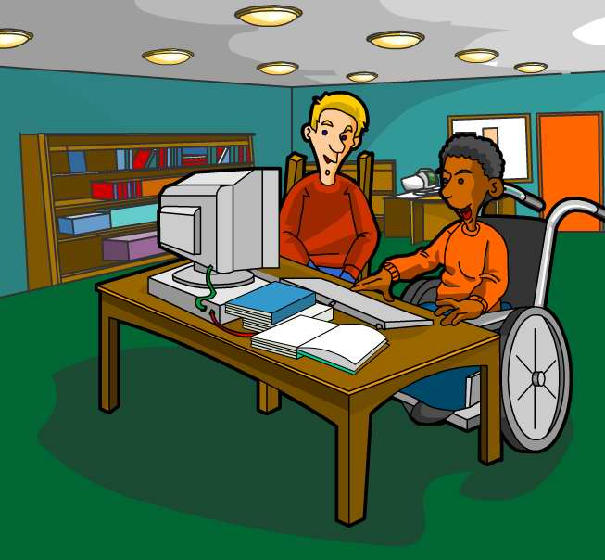
Look, this is my new program! You say the words you want and it types them for you. Guaranteed 100% accurate.
That’s amazing!

Slide 3
But the best bit is, it can change it to any language you want just by pressing this button, and it always gets it right.
Wow. Did it take long to write?
Years and years, but I’m so proud of it I’m going to give it away to everyone who wants it! Do you want a copy?

Slide 4

Did you notice anything wrong with the previous slide?
Would you give away years of work and knowledge without expecting a reward for it?
Most people feel that they have a right to be paid for the work they do.
That’s why we need copyright laws.

Slide 5
The purpose of the act
The Copyright and Patents Act aims to protect people who invent things from having their ideas stolen.
It covers software as a whole, and also the code that makes up the software.
When you buy software, you don’t actually buy the software itself. You buy the right to use it, which is called a license.
You can only use it in the way the license says you can.

Slide 6
Software licences
Single User Licences are the most common. They let you use one copy of the software on a single computer. Sometimes they let you use it on a laptop as well, as long as you don’t use both at the same time.
Multiple User Licences are often bought by companies who need lots of copies to run on a network. A 25-user licence allows them to have 25 copies of the software running and costs less than 25 single user licences.
Site Licences allow as many copies to run as the user wants as long as they are on the same site. Schools often buy software like this.

Slide 7
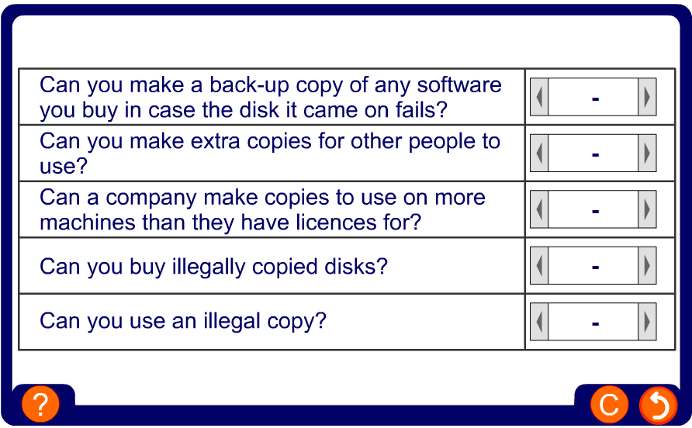
Copying software – when is it allowed?

Slide 8


Bits and pieces
It is illegal to steal the whole software program by copying it.
It’s also illegal to steal large sections of the code in order to make a similar product, though this can be hard to prove.

Slide 9
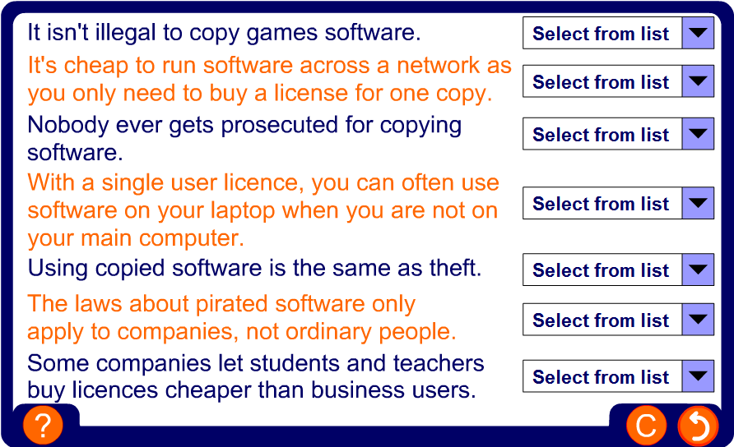
True or false

Slide 10
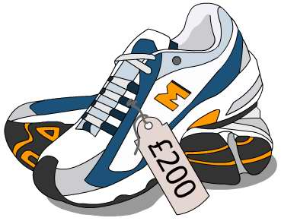
But why is it wrong?
It’s true that software is expensive, but so are new trainers and you wouldn’t take those from a shop without paying.
If software companies don’t make enough money from software, they won’t spend money on improving and developing it.
Piracy costs over £3 billion each year in Europe alone, and keeps the cost of software higher for those who do pay for it.

Slide 11

Summary
The laws of copyright aim to stop people making illegal copies of someone else’s work.
You don’t buy software, you buy a license to use it.
You can buy single user, multiple user or site licenses.
Some companies sell educational licenses for students and teachers.

